Slide 1
SRS For The Hospital Management System
AMSA Damruwan
15000273
2015/CS/027

Slide 2
ER Diagram of the application
Mapped tables for the ER diagram
Class diagram
Screen shots of the user interfaces

Slide 3
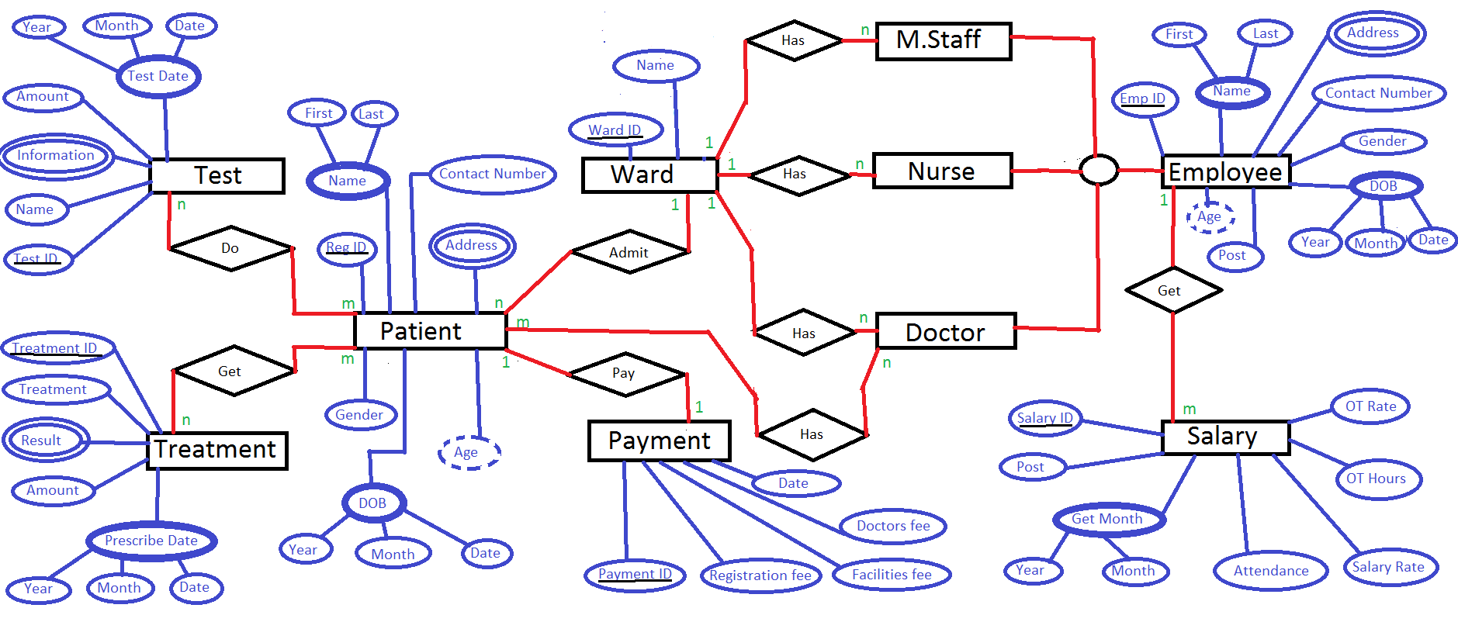
ER Diagram of the application

